Slide 1

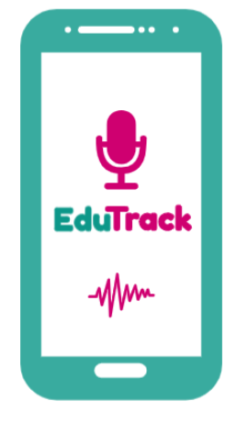
EduTrack
…the classroom companion.
The Lightweight
Audio Platform for Teachers & Students.
Powered by MSUIT.
EduTrack

Slide 2
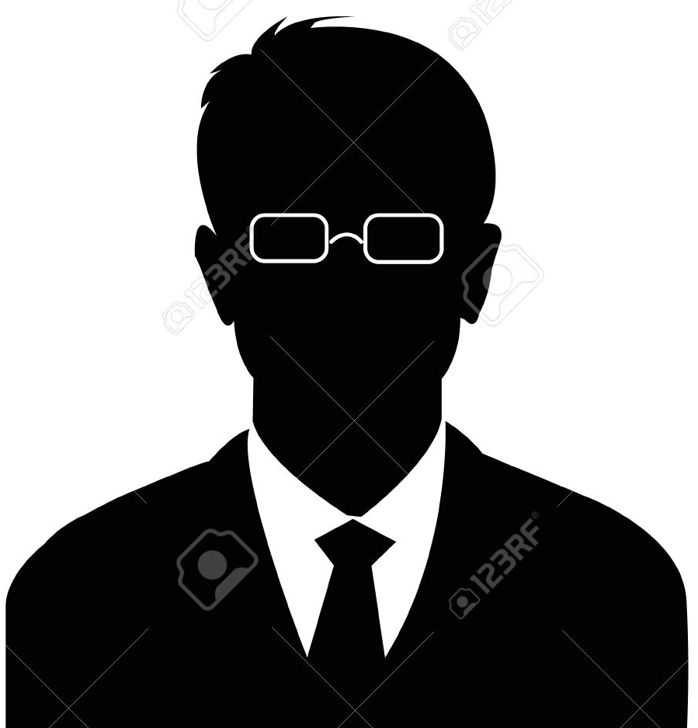
Story – Personae A.
Mr. Gwarzo is a secondary school English teacher who only comes to class only about ¹/₃ of the expected times he suppose to be in the class. Moreover, he does not diligently follows the curriculum and only cherry picks what to teach and does so for a short period of the time always.
He only stays for a whole period IF he get winds of the education ministry staff coming around for supervision. His students have also wished that he can be a bit slower when he teaches and would have thus love a recap of his classes.
On the other hand, he will always fill his lesson notes perfectly and there is a very low level of number of students that fail his subjects.
EduTrack

Slide 3

Story – Personae B.
Dr. Tosin is a University lecturer of biochemistry who only comes to class only about ¹/₂ of the expected times she suppose to be in the class. Most times, she does not cover the curriculum and only give handouts as stop-gaps.
Her students have also complained that she is soft-spoken and can be hardly heard in class when she teaches. Thus, most students are only able to attend but not learn as required. Many students thinks they will learn more if she spends more time in class to explain some hard-to-understand concepts.
EduTrack

Slide 4
Background (Research)
Teacher absenteeism is a problem in most schools. According to USAID, up to 25 percent of teachers in the developing world will be absent from work on any given day.¹
In sub-Saharan Africa, almost a third of children remain illiterate even after five years of education.² The root cause is low-quality and inequitable public services which is often due to weak accountability.²
20-30% of school children are not learning.³
¹ www.academia.edu/2380578/Teacher_Absenteeism_and_Teacher_Accountability_USAID_Paper_
^{2.} Barbra Buns et. al (2010). Making Schools Work: New Evidence on Accountability Reforms. WHO.
^{3.} https://www.brookings.edu/interactives/africa-learning-barometer/
EduTrack

Slide 5
Solution: How EduTrack Work!
Recording a class instruction with EduTrack will be extremely easy as opening a phone and clicking “record”.
Store recorded files offline and sync with a server Locally to be accessed over WLAN.
Integrate with existing LMS.
Files are compressed to acceptable sizes and storage system are managed at interval.
Accessible by all but immutable EXCEPT by school admin.
Feedback per class instruction.
EduTrack

Slide 6
Benefit EduTrack
Teacher:
  Increased quality of teaching (content, conduct)
  Learner (student) retention, promotion.
  Review of a teaching methodology.
Authorities
  Quality control of teaching content
  Quality control on teaching time (reduce absenteeism)
  Quality control over abseenteeism.
Students:
  To review lectures at a convenient time and pace.
  Provide Feedback over instruction / course.
EduTrack

Slide 7
Market Size
Higher Education Institutions:
  Over 1.2million Undergraduates in 2012/13*
Senior Secondary Schools
  Over 5million Senior Secondary Students in 2015*
Competition
Panopto
  Video based and in Europe and US
  *http://education.gov.ng/nigeria-digest-of-education-statistics/#4f43554279446d71e
EduTrack

Slide 8
Demo
EduTrack

Slide 9

Thank you
…
E seun!
EduTrack

